Slide 1
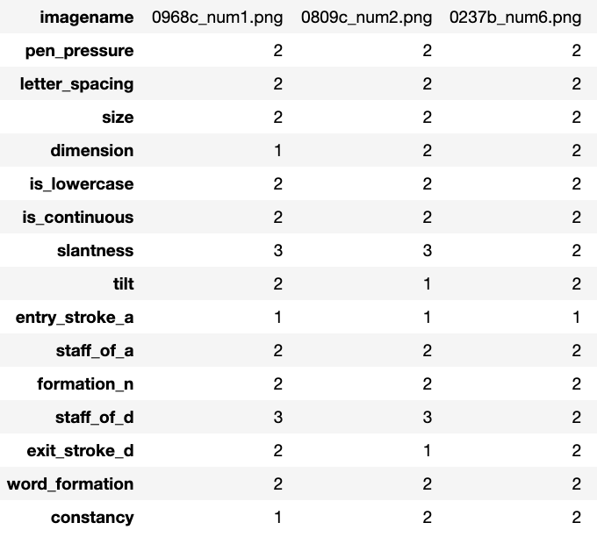
Writer Verification – Dataset
Human Observed Dataset
Number of Features: 15
 | Letter Spacing
1 | Less
2 | Medium
3 | High
 | Slantness
1 | normal
2 | Slight right
3 | Very right
4 | left
 | Word formation
1 | Not well_formed
2 | Well_Formed
 | Size
1 | Small
2 | Medium
3 | Large
 | Pen Pressure
1 | Strong
2 | Medium
 | Formation_N
1 | no_formation
2 | normal
 | Tilt
1 | normal
2 | tilted
 | Dimension
1 | Low
2 | Medium
3 | High
 | Exit_stroke_D
1 | no_stroke
2 | downstroke
3 | curved_up
4 | straight_across
 | Entry_stroke_A
1 | no_stroke
2 | downstroke
0968c_num1.png
 | Is_LowerCase
1 | No
2 | Yes
 | Constancy
1 | Irregular
2 | Regular
 | Is_Continuous
1 | No
2 | Yes
 | Staff_of_A
1 | no_staff
2 | retraced
3 | loopy
4 | tented
 | Staff_of_D
1 | no_staff
2 | retraced
3 | loopy
Image 1: Human observed features mapped to image

Slide 2
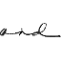
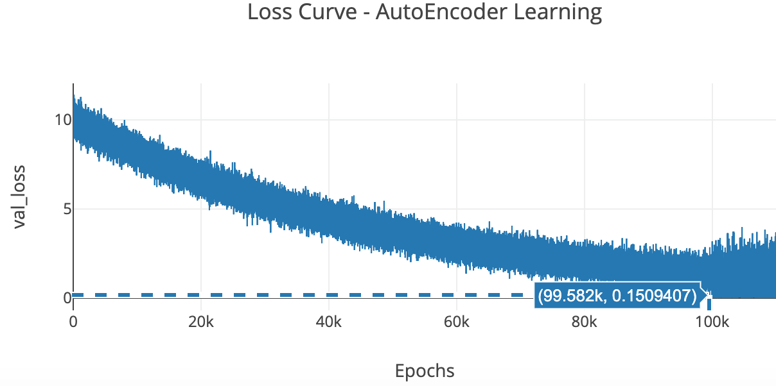
Writer Verification – Deep Learning
Srihari
The task is to evaluate how similar are two given ‘and’ image samples
32x32x16
Encoding 1
16x16x32
Encoding 2
8x8x64
Encoding 3
2x2x256
Encoding 4
1x1x512
Encoding 5
4x4x128
32x32x16
Decoding 1
16x16x32
Decoding 2
8x8x64
Decoding 3
2x2x256
Decoding 4
Image 2: Translation Invariant AutoEncoder Architecture
Loss function:
Binary Cross
Entropy (BCE)
Metric | Seen | Unseen | Shuffled
Intra Writer Accuracy (Type 1) | 84.34% | 67.31% | 78.20%
Inter Writer Accuracy (Type 2) | 96.68% | 94.54% | 96.12%
Overall Accuracy | 96.87% | 95.27% | 96.26%
Table 1: Performance Metrics
Symbol | Description | Parameters
 | Convolution (Conv) + MaxPooling (MP) | Conv_kernel = 3x3, stride = 1x1
 | DeConvolution (Deconv) + UpSampling (U) | Deconv_kernel = 3x3, stride = 1x1
 | Concatenation | encoding + decoding
Table 2: Image 2 Legend
Image 3: Loss Curve

Slide 3
Writer Verification – Deep Learning - Results
Srihari
Evaluation Phase
Intra Class Type 1 Error
Inter Class Type 2 Error
Encoder
Encoder
1x512
1x512
Cosine Similarity Threshold: 0.6
True Positive
(TP)
True Negative
(TN)
False Positive
(FP)
False Negative
(FN)
Divide by # of samples in the respective writer sets
TP+TN
Divide by # of samples in Evaluation Set
Divide by # of samples in Evaluation Set
Type 1 Accuracy
Overall
Accuracy
Type 2 Accuracy

Slide 4
Terminologies
False Positive (FP) [Type 2]: System claims a pair of samples are a match, when they are actually samples of different identities.
False Negative (FN) [Type 1]: System claims a pair of image samples are a mismatch, when they are actually samples of the same identity.
Precision (P): TP/(FP+TP)
Recall (R): TP/(TP+FN)
Balanced Error (BE):
Used to predetermine the threshold values.
When the P and R are equal, the common value is referred to as the balanced error rate.
For distance based thresholds like Euclidean, lower the BE value, the higher the accuracy of the system.
For similarity based thresholds like Cosine, higher the BE value, the higher the accuracy of the system.

Slide 5
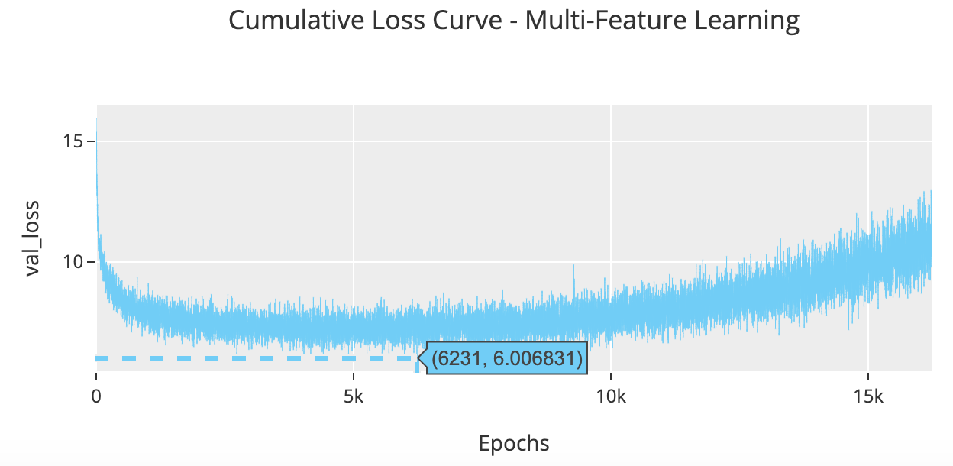
Writer Verification – Explainable AI
Flatten_1
Hidden_1
SoftMax_1
Pen Pressure Category
32x32x16
Encoding 1
16x16x32
Encoding 2
8x8x64
Encoding 3
2x2x128
Encoding 4
1x1x256
Encoding 5
4x4x128
1 Fully Connected for each feature.
Total 15 features
Flatten_15
Hidden_15
SoftMax_15
Constancy Category
Loss for each feature:
Categorical Cross Entropy (CCE)
Image 4: Explainable Model Architecture
Explanability:
Compare corresponding ‘SoftMax_x’ (x : {1 to 15}) of two images using cosine similarity to obtain feature wise explanation
Compare ‘Encoding 5’ (latent) of two images using cosine similarity for Overall Similarity
Metric | Seen | Unseen | Shuffled
Intra Writer Accuracy (Type 1) | 88.12% | 70.82% | 80.98%
Inter Writer Accuracy (Type 2) | 95.58% | 93.49% | 95..08&
Overall Accuracy | 95.78% | 94.27% | 95.23%
Table 4: Performance Metrics based on Overall similarity
Image 5: Validation Loss Curve – Average of Sum of CCE over each Feature

Slide 6
Writer Verification – Explainable AI - Results
Cosine Similarity
Threshold: 0.8
True Negative
Cosine Similarity
Threshold: 0.8
False Negative
Left Classes | Right Classes
Strong | Strong
High | Medium
Large | Medium
Medium | Medium
No | Yes
No | No
Normal | Normal
Normal | Tilted
No Stroke | No Stroke
No Staff | Tented
Normal | No Formation
No Staff | Loopy
No Stroke | Downstroke
Not Wellformed | Not Wellformed
Irregular | Irregular
Left Classes | Right Classes
Medium | Medium
Medium | Medium
Large | Medium
Medium | Medium
Yes | Yes
No | Yes
Normal | Slight Right
Normal | Normal
No Stroke | No Stroke
Retraced | Retraced
Normal | Normal
Loopy | Loopy
Downstroke | Downstroke
Wellformed | Wellformed
Regular | Regular
Table 5: Predicted
Classes
Table 5: Predicted
Classes
Image 6: Graph of Similarity Score
of Left & Right Image Features
Different Writer Samples
Image 7: Graph of Similarity Score
of Left & Right Image Features
Same Writer Samples
Report Card of Comparing two Samples

Slide 7
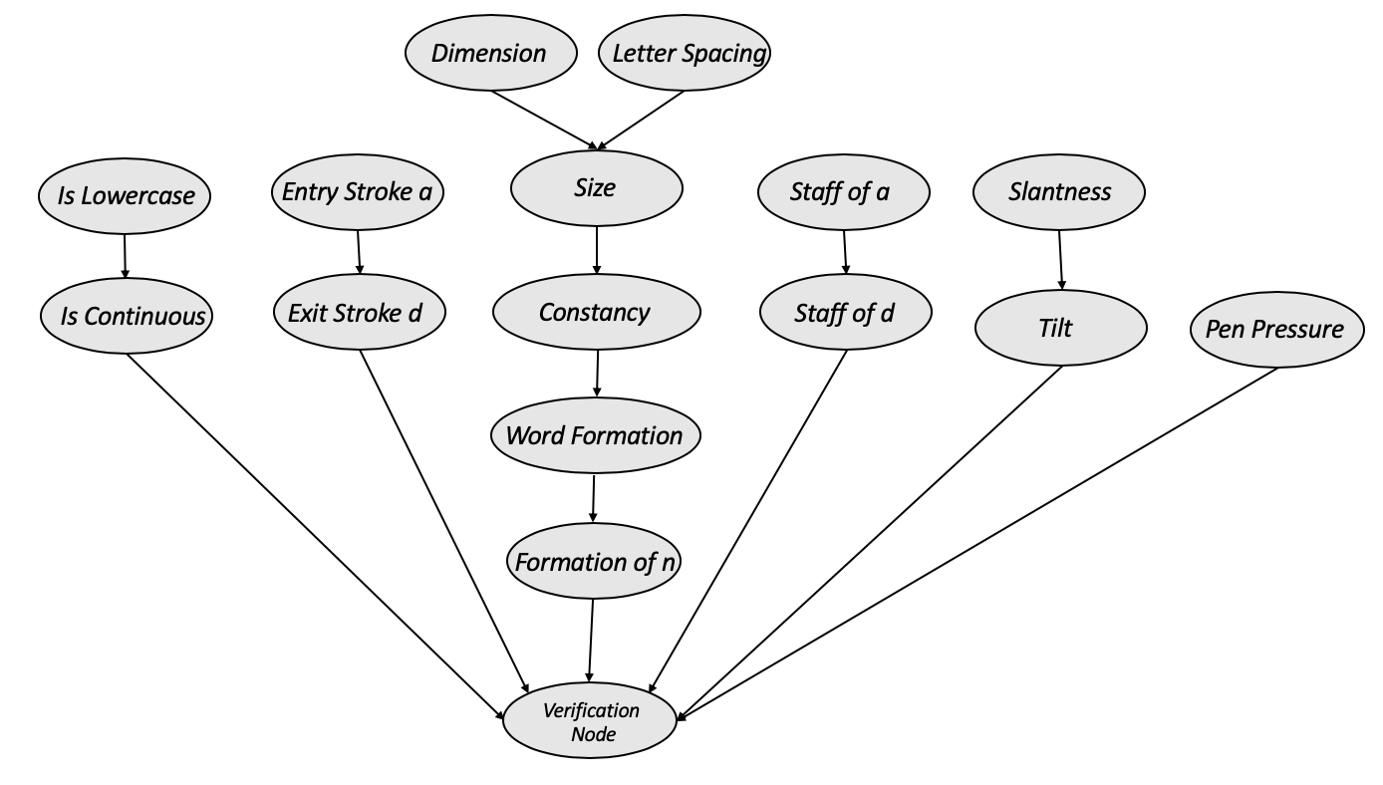
PGM for human observed ‘AND’ dataset

Slide 8
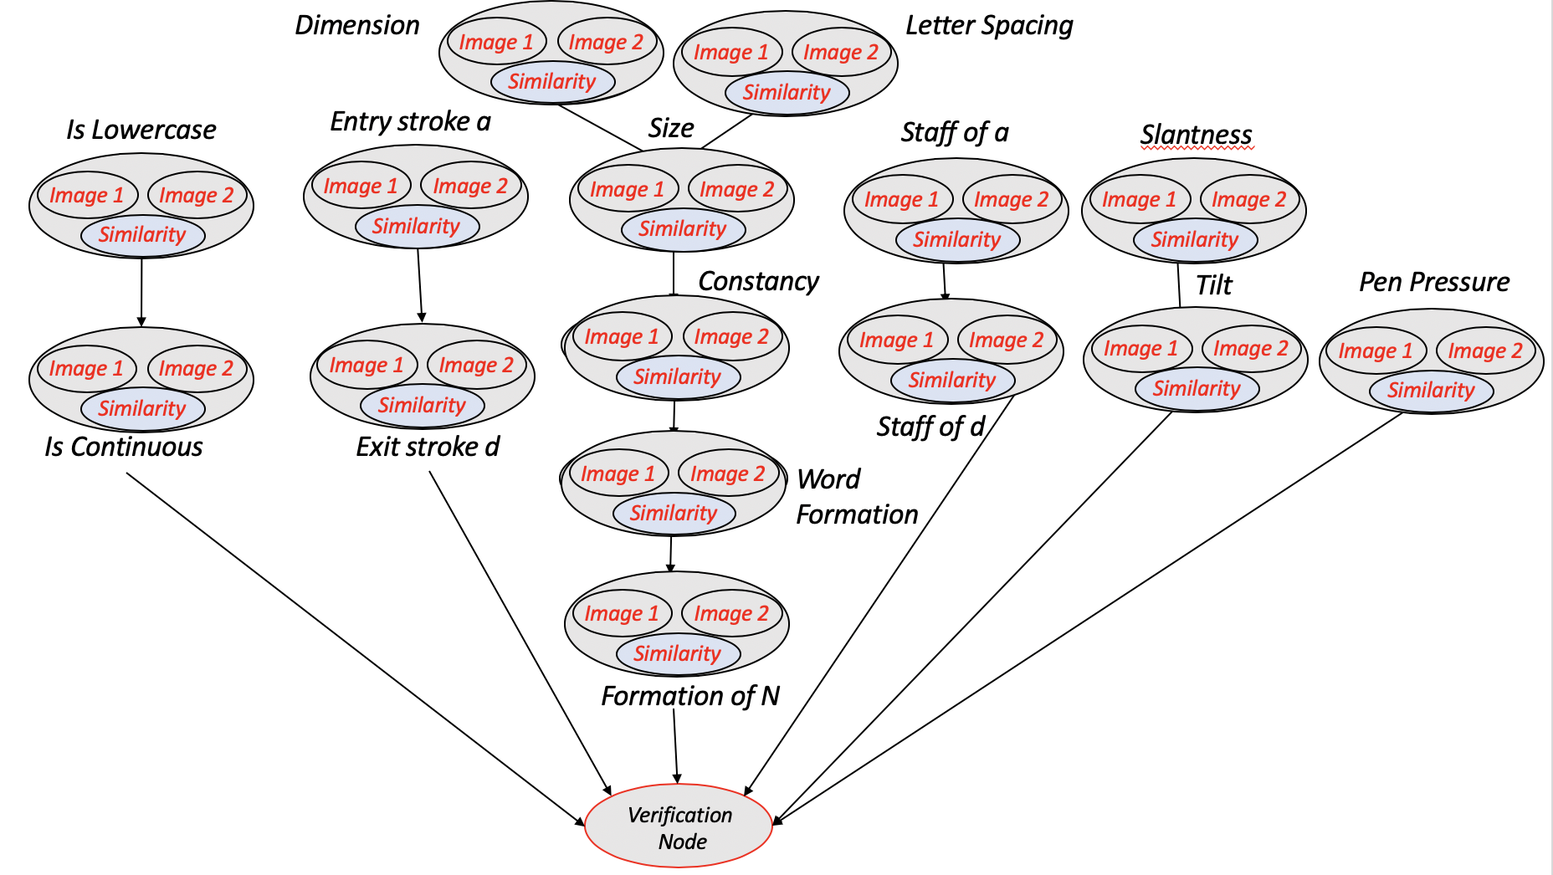
PGM for Writer Verification

Slide 9
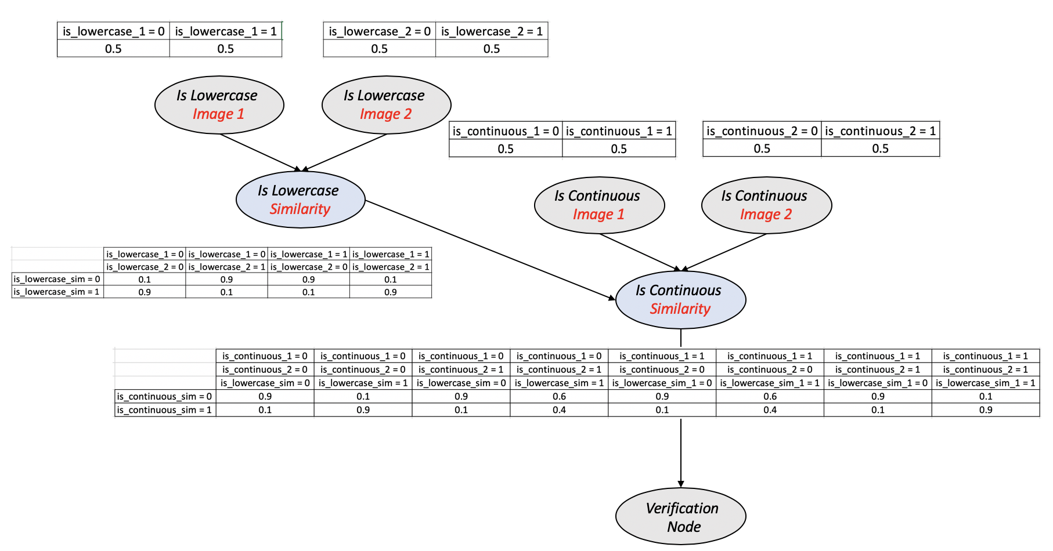
Example CPDs for Writer Verification PGM
All CPDs are handcrafted based on Expert Intuition

Slide 10
References
AutoEncoder Code Reference:
Deep Learning + Cosine Similarity Code
XAI Code Reference:
Feature mapping + Cosine Similarity Code
PGM Code Reference:
PGM Structure + XAI Verification
Datasets:
Seen + Unseen + Shuffled
All Codes: https://github.com/mshaikh2/HDL_Forensics/tree/master/AML_SPRING_2019

